Slide 1
Notes:
Welcome to this tutorial on the revised e-asTTle Writing tool. The revised tool is available from term two, 2012. The purpose of this tutorial is to introduce schools to the new tool, to clarify the revisions that have been made to the tool, to show how to administer and mark the assessment, and how to analyse the results to support teaching and learning. The information in this tutorial needs to be understood in conjunction with that in the manual, which is intended to provide detailed and comprehensive information on the use of the tool, and the technical aspects which support it.

Slide 2
You can use this presentation to:
Gain an overall understanding of the purpose of the revised tool
Learn about the changes that have been made
Find advice about the administration and marking of assessments
Learn how you can analyse and use results to support teaching and learning.
Notes:
The revised e-asTTle writing is an on-line assessment tool which assesses students’ achievement and progress in writing from years 1 to 10. It assesses students’ ability to independently write continuous text across a variety of purposes.
An e-asTTle writing test involves students writing for up to 40 minutes, responding to a set prompt. Teachers then use a rubric, supported by notes and exemplars, to score the writing against seven different writing elements. The tool is able to convert the rubric scores to scale scores and curriculum levels, and then produce a range of reports for individual students or groups of students.
The results from e-asTTle Writing contribute to the information teachers and students can use to establish next steps in learning, monitor progress over time and make decisions about learning priorities. Results also provide achievement information in relation to national curriculum levels, and national norms, for school-wide decision making.

Slide 3
Overview of e-asTTle Writing (revised)
The tool assesses writing from Years 1-10.
It assesses students’ ability to write continuous text over 40 minutes.
Markers use a rubric to score against seven elements.
The tool converts teacher marking into scaled scores and curriculum levels.
Reports provide information for students, teachers and school leaders.
Results should be used in conjunction with other evidence to track achievement and progress.
Notes:
The revised e-asTTle writing is an on-line assessment tool which assesses students’ achievement and progress in writing from years 1 to 10. It assesses students’ ability to independently write continuous text across a variety of purposes.
An e-asTTle writing test involves students writing for up to 40 minutes, responding to a set prompt. Teachers then use a rubric, supported by notes and exemplars, to score the writing against seven different writing elements. The tool is able to convert the rubric scores to scale scores and curriculum levels, and then produce a range of reports for individual students or groups of students.
The results from e-asTTle Writing contribute to the information teachers and students can use to establish next steps in learning, monitor progress over time and make decisions about learning priorities. Results also provide achievement information in relation to national curriculum levels, and national norms, for school-wide decision making.

Slide 4
Key Changes
Scope of the tool
Writing assessment prompts and purposes
Marking rubric
Annotated exemplars
Measurement scale
Report information and formats
Notes:
While some features remain similar to the original e-asTTle writing assessment, the new version of the tool represents a substantial revision.
The following features of the tool have been revised: The scope of the tool, the writing assessment prompts, the marking rubric, the annotated exemplars, the measurement scale, and parts of the information provided by the reports, and some report formats. Each one of these changes will be addressed separately in the slides following.
The writing tool has been redeveloped to respond to the writing demands of the New Zealand Curriculum, and align with the Literacy Learning Progressions and the National Standards.

Slide 5
Scope of the tool
The tool can now be used to assess writing from students in Year 1 through to Year 10. The previous version assessed from Year 4 to Year 10.
In order to be assessed accurately by the new tool, students should be able to write at least one or two simple ideas.
Notes:
The scope of the tool has changed. Where the previous version assessed students’ writing from Years 4 to 10, the new version of the tool can be used to assess writing from students in Year 1 through to Year 10.
However, the tool is suitable only for students who are able to independently write at least one or two simple ideas. Students who score in the lowest category for every element assessed are not well targeted by the assessment, as it may not accurately indicate the students’ skills and next learning steps.

Slide 6
Prompts and purposes
The tool emphasises ‘prompts’ rather than ‘tasks’.
20 open-ended prompts encourage students to choose subject matter relevant to their experience.
There is a range of prompts for younger or older students.
There are now five writing purposes, relevant to writing across the curriculum areas.
Notes:
The revised tool emphasises writing ‘prompts’ rather than ‘tasks’. This emphasis change is designed to encourage students to draw on their individual and cultural knowledge to interpret the writing topic, rather than prescribing what students will write about. There are 20 new prompts which are designed to be as open-ended as possible so that students can choose their own subject matter and bring their own ideas to the writing. Only two prompts, both asking students to describe life cycles, have set subject matter. Some prompts have been specifically designed to suit younger or older students.
The new prompts have been developed across five purposes in this tool revision. The purposes - to describe, to explain, to recount, to narrate and to persuade - are important to writing in general rather than specific to any particular learning area. They have been chosen after extensive consultation with schools about the most relevant purposes for writing.

Slide 7
Rubric
There is now one rubric for all writing purposes.
There are seven elements of writing, similar to those in the previous version but with changes that require a shift in thinking by teachers.
The rubric has been developed from the NZ Curriculum, the Literacy Learning Progressions, and an analysis of student responses to writing prompts.
There is a range of achievement categories (rubric scores) on a continuum from R1 to R6 or R7 for each element.
Notes:
A new single marking rubric has been developed, which is used to assess writing for any of the five writing purposes. This is a significant change from the previous tool, which had a separate rubric for each writing purpose.
The rubric focuses on seven elements of writing and gives very specific information about each element. The elements are Ideas, Structure and Language, Organisation, Vocabulary, Sentence structure, Punctuation and Spelling. These elements are similar to those in the previous version, but will require a shift in thinking for those using the tool. We will look at the changes in the elements in more detail later in this presentation.
The rubric is based on, and linked to, the New Zealand Curriculum and the literacy learning progressions. In conjunction with these, it has been developed through analysis of actual student work which was produced in response to the writing prompts. This means that the category descriptors and the rubric indicators for each element have been derived from looking at thousands of scripts of students’ writing and analysing where the natural progressions fell. This continuum of characteristics has been shown as a range of achievement categories (R1 to R6 or R7) for each writing element. These achievement categories are know as rubric scores and are converted within the tool to e-asTTle writing scores.
The assignment of rubric scores is a key difference between the new and previous versions. There is no longer a reference to curriculum levels in the marking rubrics and no requirement for markers to determine a beginning, proficient or advanced rating in relation to curriculum level indicators. Curriculum level and sub level scores are determined by the e-asTTle tool after writing scripts have been marked and entered in e-asTTle.

Slide 8
Annotated exemplars
There are 76 new annotated exemplars.
They include specific exemplars to accompany each writing prompt and a set of generic exemplars.
The exemplars are actual samples of student writing, and are representative rather than ideal examples.
The annotated exemplars are essential tools for ensuring consistent scoring decisions.
Notes:
There are 76 new annotated exemplars in total. These include examples specific to each new writing prompt, and a set of generic exemplars which show scoring and annotations across a wider range of prompts. The exemplars are representative, rather than ideal examples of writing. They have been scored using the writing rubric and explain the thinking behind each scoring decision.
The annotated exemplars are essential tools for developing an understanding the rubric indicators and the progressions within the rubric. Markers must always use them in conjunction with the rubric to make consistent scoring decisions.

Slide 9
Where to find the specific exemplars
Each prompt has a set of annotated exemplars which are specific to that prompt. For example, the recount prompt ‘Time with friends’ has four exemplars specific to that prompt, at different achievement levels.
The specific exemplars can be downloaded after a prompt has been chosen. To print them, choose the View Test button, or go to the Print Options page. They will be printed along with the guidelines, the test, the rubric and the glossary.

Slide 10
Measurement scale
There is a new measurement scale which is linked to curriculum bands.
The new scale is not directly comparable to the previous e-asTTle Writing scale.
A conversion table is being developed to provide some comparison between scores in the new and previous versions.
Notes:
A new measurement scale has been constructed for e-asTTle Writing, and is linked to curriculum level bands. The scale scores still fit within the normal range of e-asTTle scores. However, the new scale has been developed from the scoring of students’ writing using the new prompts and rubric and is therefore not directly comparable to the original scale. This means that, at the moment, results from the previous version can not be compared in order to track progress or calculate ‘value-added’. Work is being done by the Ministry of Education to develop a conversion table to provide some comparison between scores in the new and previous versions.

Slide 11
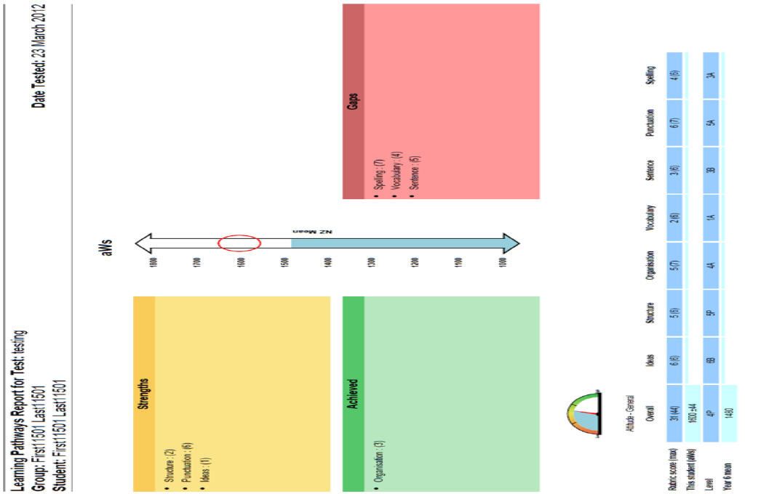
Report formats
There are some minor changes to the report formats to accommodate the new rubric, described later in this presentation.
Notes:
The revised tool uses the same report formats that are used for other e-asTTle tools such as e-asTTle Reading and Maths. However, some changes have been made to accommodate the use of the new rubric and to ensure the information is clear. These changes will be described in detail later in the presentation.

Slide 12
Creating, administering and marking tests
Detailed information on how to create, assign, administer and mark an assessment can be found in Section 3 of the e-asTTle writing manual.
Notes:
Section 3 of the e-asttle Writing manual has a detailed description of how to create, assign, administer and mark a writing assessment. For those familiar with the previous version of the tool, the process is similar. The next part of this presentation will focus on the aspects that are different from the previous version.

Slide 13
Advice when creating a test
Technical instructions, found in Section 3.1 of the manual are similar to those in the previous version.
The writing purpose needs to be chosen with care.
You need to become familiar with the new prompts to ensure the chosen prompt is appropriate for the students.
You can choose different prompts for an assessment but this makes administration more difficult.
Notes:
Section 3.1 of the manual provides instructions for creating a test. The technical aspects are very similar to the previous version.
There is a new range of prompts (formerly called tasks) for each writing purpose. The choice of purpose and prompt needs careful consideration. Some purposes require a more complex structure – for example, the Narrate purpose – and may not be suitable for younger students.
Once users have chosen a purpose, they will need to become familiar with the new prompts to ensure the chosen prompt is appropriate for the students. Remember, some prompts are more suitable for older students, and some for younger. The ‘recount’ and ‘describe’ prompts are written in language which is more easily accessible for younger students.
It is acceptable to choose more than one prompt to assess writing within a group of students. This may increase the engagement of different groups of students. However, this will make administration more difficult as time will be spent explaining each prompt to students.

Slide 14
Supporting material provided with a prompt
Clicking on ‘View Test’ provides the following material:
The administration guidelines
The test
A glossary and definitions of terms
The marking rubric
Notes on structure and language particular to the writing purpose
The annotated exemplars particular to the prompt
Notes:
When you have created a test there is a range of supporting material which can be viewed and downloaded for administration and marking. Clicking on ‘View Test’ provides the following material:
The administration guidelines
The test
A glossary and definitions of terms
The marking rubric
Notes on structure and language particular to the writing purpose
The annotated exemplars particular to the prompt.
It is essential that you become familiar with this material before administering and marking the test.

Slide 15
Assigning a test
Section 3.1.3 of the manual provides instructions for assigning tests to groups of students.
The test must be assigned before scores can be entered.
The technical instructions are the same as in the previous version.
Notes:
Section 3.1.3 of the manual provides instructions for assigning tests to groups of students. As with the previous version, the test must be assigned before any scores can be entered. The technical instructions are the same as in the previous version.

Slide 16
Test administration
Section 3.2 of the manual provides detailed instructions for administering the test.
Administration guidelines have changed and it is important that they are followed carefully.
Statistical norms have been established using the administration guidelines, so following them will provide valid comparisons.
Notes:
Section 3.2 of the manual provides instructions for administering the test.
It is important that you read and follow the administration guidelines carefully. They provide very specific instructions on what to do and what to say to students. The statistical norms have been established by testing students using this procedure, so following the instructions will provide valid comparisons with the normed achievement levels.

Slide 17
Marking the test
Sections 3.2.3 and 3.2.4 of the manual provide instructions for marking the test.
It is essential that all markers are familiar with the supporting material.
A useful process for developing common understandings is to mark a text or two collaboratively.
Notes:
Sections 3.2.3 and 3.2.4 of the manual provide detailed instructions for marking the test.
It is essential that all markers are familiar with the supporting material. This includes:
The writing prompt
The marking rubric
The structure and language notes
The annotated exemplars specific to the prompt
The generic exemplars
The glossary and definitions of terms.
A possible process for familiarising markers with the support material is to mark a text or two collaboratively. Begin with the prompt and the marking rubric and discuss the progressions in each element. Use the glossary to explore any terminology that may not be clear. Consult the exemplars (both specific and generic) to see how the tool developers interpreted the indicators. The structure and language notes are specific to each purpose and should be consulted when marking this element.

Slide 18
The elements in the rubric
Markers assess seven elements of writing (previously called ‘curriculum functions’).
The seven elements are: Ideas, Structure and language, Organisation, Vocabulary, Sentence structure, Punctuation, Spelling.
There are some differences between the elements in the new tool and curriculum functions in the previous tool, which require a shift in thinking.
Notes:
There are seven elements of writing, each with its own rubric. The elements are similar to the ‘curriculum functions’ in the previous version. Markers will need to assess against each of the new elements. The elements are: Ideas, Structure and language, Organisation, Vocabulary, Sentence structure, Punctuation, and Spelling.
Although you will notice similarities with the previous version, there are some significant changes which will require some shifts in thinking. A key change that you will notice is the absence of ‘audience and purpose’ as a separate element. This element has now become incorporated into each of the other elements. For example, the ‘ideas’ element is marked in part on the text’s ability to ‘engage and influence the reader’.
In particular, the ‘Structure and language’ element focuses on the purpose of the text. The Structure and Language notes describe the specific features which make a piece of writing appropriate to its purpose. There is a different set of Structure and Language notes for each writing purpose.

Slide 19
Layout of the rubric
Notes:
Figure 1 on page 11 of the manual is an annotated page from the rubric. It explains each part clearly and its role in the marking process.
Each rubric has a description of the skill focus of the element, a definition of the element, progression descriptors against which the text will be marked, notes to help with marking decisions, and a list of the generic exemplars which will support markers to make their decisions.

Slide 20
Points to consider when marking
Score each element based on the evidence for that skill focus. Ensure particular strengths or problematic features are assessed only within the relevant element.
The tool assesses writing, not the accuracy of content knowledge.
Descriptors are hierarchical and cumulative.
Ideas can be only loosely related to the topic and still be assessed.
Notes:
There are several important points to consider when marking a text.
Each element should be scored independently. It is important to understand the skill focus for each element so that particular strengths or problematic features are assessed only within the relevant element.
E-asTTle writing assesses generic writing competence, not students’ content knowledge of a particular subject. Texts should therefore not be marked down for factual inaccuracies.
Descriptors are hierarchical and cumulative. This means that the assignment of a rubric score, for example ‘R4’, assumes that the text achieves all the indicators that come before it. However, minor omissions in the lower indicators are acceptable.
Ideas can be loosely related to the topic and still be considered on topic.

Slide 21
Moderation
Moderation processes are essential to ensure consistency of scoring across a group of markers.
The moderation process is the same when using the revised tool.
Support can be found in the moderation section of Assessment Online.
Notes:
Moderation processes are essential to ensure consistency of scoring across a group of markers. Many schools will have developed a robust process for moderating writing assessments and this process will be the same using the revised tool. For schools that need assistance in developing their moderation systems, there are various support materials available. The moderation section of Assessment Online has useful resources.

Slide 22
Entering scores
Notes:
Once tests have been marked and moderated, scores can be entered in the e-asTTle tool. Section 3.2.6 of the manual provides instructions for this.
The process for entering scores is very similar to the previous version. However, you will be entering rubric scores rather than curriculum levels and sub levels. The tool will convert the rubric scores into scale scores and curriculum levels.

Slide 23
Understanding scoring
The marker allocates a rubric score for each element of writing.
Rubric scores are converted to scale scores on the e-asTTle writing scale.
Scale scores are also represented as curriculum levels and sub-levels.
Curriculum sub-levels correspond to a range within the e-asTTle writing scale.
Notes:
Let’s recap the different scores within e-asTTle Writing.
The rubric score is the category the teacher identifies when marking a text. The marker will choose a rubric score for each of the elements of the rubric. As we noted earlier, the rubric was developed from an analysis of thousands of scripts produced by New Zealand students and represents a continuum of achievement.
Rubric scores are converted into scale scores and added to produce a combined e-asTTle Writing score (an aWs). The writing scores will be within the range of 1000 to 2000, as in the previous tool.
Scale scores are also converted into curriculum levels and sub-levels.
Curriculum sub-levels correspond to a range of scores on the asTTle Writing scale. For example, all scores within the range of 1423 and 1459 are reported as 3-basic or 3B.

Slide 24
Key points when interpreting scores
Sections 4.1 and 4.2 of the manual provide detailed information on interpreting scores.
Rubric scores are useful for identifying next learning steps with students.
Rubric scores should not be used for comparing performance.
Use scale scores to make decisions based on comparative judgments.
Notes:
Sections 4.1 and 4.2 of the manual provide detailed information regarding the interpretation of test scores. There are some key points to note when interpreting rubric scores and scale scores to make decisions for teaching and learning:
Rubric scores are useful when used with students to locate current indicators of performance for particular elements on the marking rubric and identify next learning steps. When using rubric scores to interpret information, however, you should take into account that:
The rubric scores are not necessarily comparable across elements. For example, a rubric score of ‘R2’ in Spelling may be easier to achieve than an ‘R2’ in Ideas. Additionally, the skill progression between rubric scores is not a constant.
Also, the rubric scores are not comparable across different writing prompts as it is more difficult to score highly on some prompts.
It is not valid, therefore, to make comparative judgments based on rubric scores. However, the above issues are accounted for when rubric scores are converted into scale scores. Scale scores should be used when comparing achievement in relation to norms and measuring progress over time. This is possible for individual students or groups of students.

Slide 25
Measurement error
No measurement can ever be completely precise. Each scale score is estimated within a margin of error.
The margin of error describes the range of scores within which one can be reasonably confident (70%) that a student’s true achievement lies.
The margin of error is indicated on the student’s Individual Learning Pathway.
When interpreting and comparing results, the margin of error should always be taken into consideration.
Notes:
Sections 4.1 and 4.2 of the manual provide detailed information regarding the interpretation of test scores. There are some key points to note when interpreting rubric scores and scale scores to make decisions for teaching and learning:
Rubric scores are useful when used with students to locate current indicators of performance for particular elements on the marking rubric and identify next learning steps. When using rubric scores to interpret information, however, you should take into account that:
The rubric scores are not necessarily comparable across elements. For example, a rubric score of ‘R2’ in Spelling may be easier to achieve than an ‘R2’ in Ideas. Additionally, the skill progression between rubric scores is not a constant.
Also, the rubric scores are not comparable across different writing prompts as it is more difficult to score highly on some prompts.
It is not valid, therefore, to make comparative judgments based on rubric scores. However, the above issues are accounted for when rubric scores are converted into scale scores. Scale scores should be used when comparing achievement in relation to norms and measuring progress over time. This is possible for individual students or groups of students.

Slide 26
Reports
e-asTTle provides a range of reports to support teaching and learning.
There are changes to the the Individual Learning Pathway report (ILP), the Curriculum Levels report, and the Tabular Output report.
Section 4.3 of the manual gives a detailed description of changes to the reports.
Information on interpreting the other e-asTTle reports can be found in the original online e-asTTle Educator Manual
Notes:
e-asttle is primarily a formative assessment tool. As such, it produces a range of reports which you can download and use to support teaching and learning for groups or individual students.
There are changes to the Individual Learning Pathway (or ILP), the Curriculum Levels report and the Tabular Output report. All other reports are the same as the previous version.
Changes to the Curriculum Levels report and Tabular Output report are minor. The Curriculum Levels report now includes rubric scores as well as curriculum levels for each element. The Tabular Output report no longer provides scores for surface and deep features of writing, as it is considered impossible to categorise the elements that have been assessed as only surface or deep.
There are more substantial changes to the Individual Learning Pathway report. These will be described in the following slide.
Section 4.3 of the manual provides a description of key changes to the reports, and you can find general information about e-asTTle reports in the original online e-asTTle Educator Manual.

Slide 27
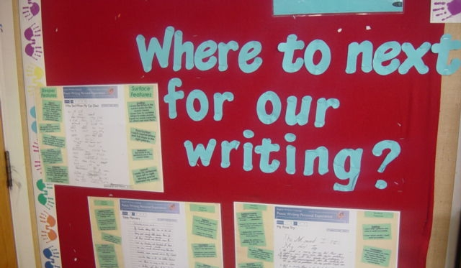
Formative use of results
The purpose of every e-asTTle assessment should be to determine what the student now knows and can do, and what they might learn next.
Notes:
The purpose of every e-asTTle assessment should be to determine what the student now knows and can do, and what they might learn next. The assessment should provide this information to both the students and to the teacher. The assessment should not be about only obtaining a score, although it may well be about wanting to monitor and celebrate progress. The key is the interpretation of any score or information from an assessment and a major function of e-asTTle is to assist in providing these interpretations.
The following slides will give more information on some key ways to use results formatively, in order to meet the overall purpose of the e-asTTle assessment, to improve teaching and learning.

Slide 28
The individual learning pathway report
Notes:
Figure 3 on page 19 of the manual shows an annotated example of the ILP and section 4.3 provides information regarding changes in the ILP report. The ILP in the revised version differs in several ways:
The rubric scores for each element are shown on the report. This allows the teacher and student to return to the rubric to locate current skill indicators and identify potential next learning steps. The number in brackets beside the rubric score is the maximum score available for that element.
Scale scores and the ‘dials’ showing comparison with national norms are provided only for the overall score, not for each individual element as in the previous version. This is because the scale score is precise enough to make confident interpretations only when it is accumulated into an overall writing score. However, curriculum levels and sub-levels are provided for each element to give a broad indication of level of performance.
A margin of error relative to the student’s scale score is indicated. This margin is also represented by the width of the circle in the graphic in the middle of the report. You can read more about margins of error in section 4.1.1 of the manual.
Scores for shallow and deep features are no longer provided.
As in the previous version, the elements in the boxes represent strengths, expected achievement levels, and gaps in relation to the student’s overall writing score.

Slide 29
Using the ILP report formatively
Notes:
A good starting place for using information formatively is to look at the ILP report with a student or group of students. Students may have to be taught how to read the report and teachers may choose to set aside time to do this with a group of students.
Give students their ILPs and ask them to identify the areas of writing in which they have strengths and gaps. Discuss and define those elements of writing. When the ‘gaps’ have been identified and defined, return to the rubric for that element. The ILP will show the rubric score for each element. Students are able to identify their next steps for all areas, and particularly areas of weakness. This is a good opportunity for specific goal setting with and by students.
The teacher will need to identify the areas of specific learning need and deliberately plan to teach to those needs.

Slide 30
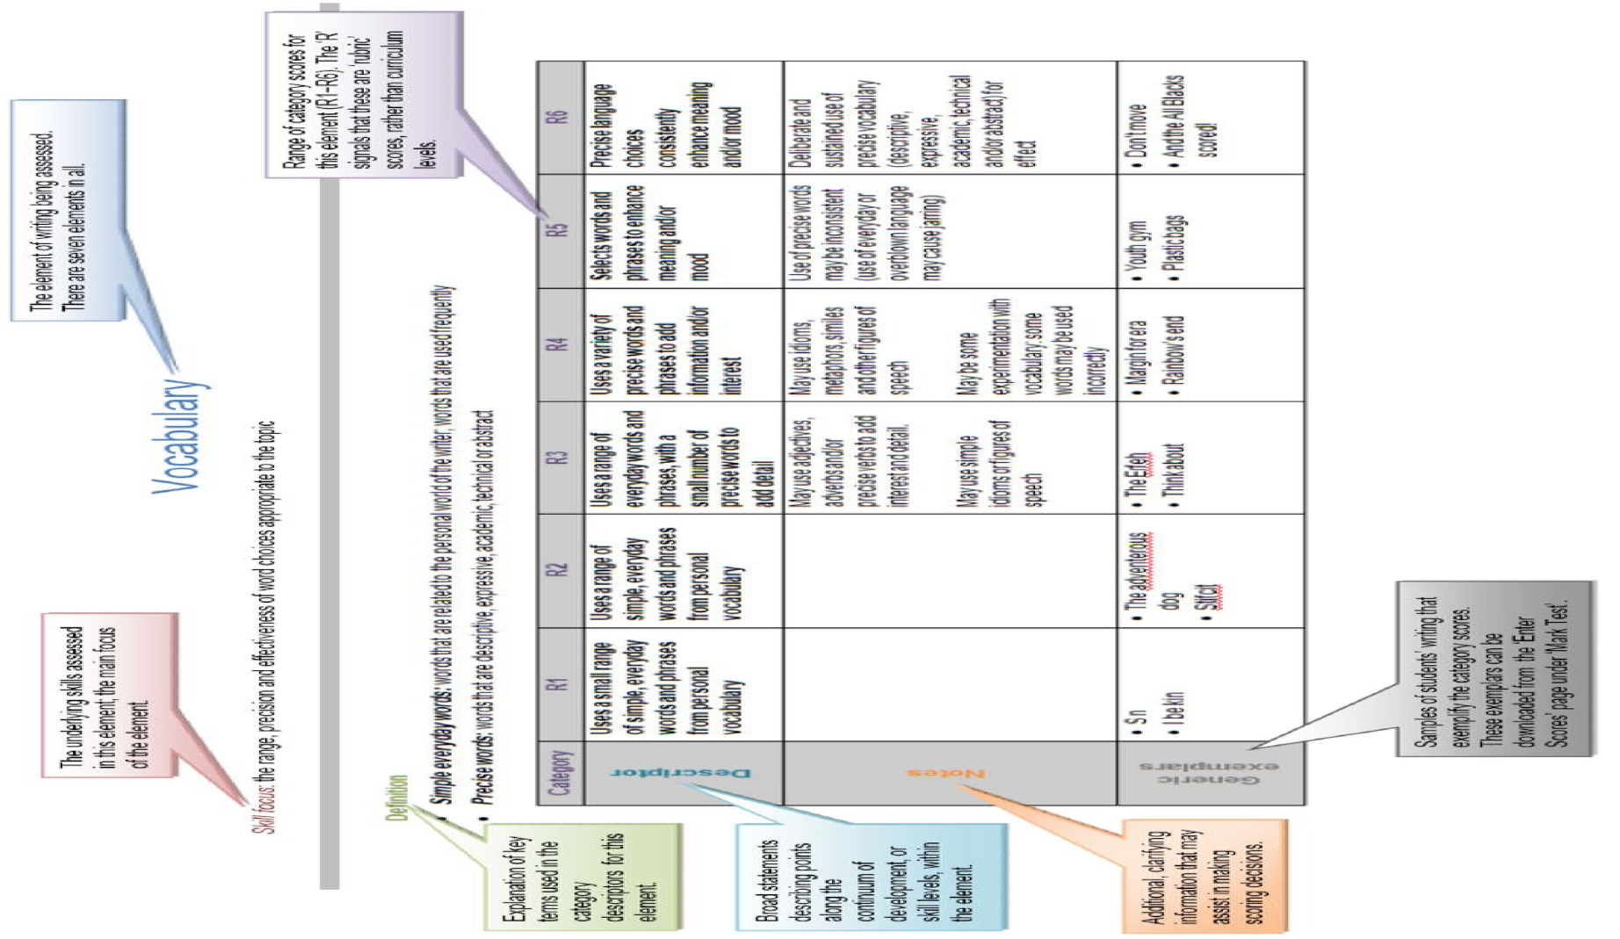
Using the marking rubric formatively
Notes:
The rubric is a useful formative tool. It can be used in conjunction with the ILP, as described on the previous slide, to determine next steps.
A rubric can also be attached to the sample of writing, so the student has a record of achievement for the assessment. If the rubric is used for subsequent assessments, students can track their progress over time. Students may keep this information in their portfolios, along with other evidence of their learning in writing. It’s a powerful motivator for students to be able to recognise how much they have improved over time.
By sharing all this information with students, and making sure they understand it, the teacher promotes student self-monitoring and ownership of their learning. The students will be able to discuss their results and learning needs with the teacher, their peers, and their family and whanau.

Slide 31
The What Next profile
Notes:
The What Next profile, available in the ‘View Reports’ screen of e-asTTle, provides links to teaching and learning resources and examples at the specific curriculum level of a student or group of students. This is a valuable tool for supporting teachers and students to address the learning needs identified in e-asTTle assessment.

Slide 32
Using all reports formatively
The Console report
The Group Learning Pathway report
The Individual Learning Pathway report
The Curriculum Levels report
The Tabular Output report
The Progress Report
The What Next profile
Each of these reports can formatively support teaching and learning. Sharing the information with students helps them to set goals and take responsibility for their own learning.
Notes:
The revised version of e-asTTle Writing produces the same range of reports as the previous version. These are:
The Console report
The Group Learning Pathway report
The Individual Learning Pathway report
The Curriculum Levels report
The Tabular Output report
The Progress Report, and
The What Next profile.
Each of these reports has a formative function to support teaching and learning. Teachers will find advantages in sharing this information with classes and will find various ways of doing so. Sharing information with students and being transparent about assessment purpose, process and results, supports the principles of effective assessment described in the New Zealand Curriculum.

